Slide 1

BUAN6320 Group Project
NEXUSMART
By GROUP 1 (Divya Srishti, Swaroop Dasagrandhi, Anubha Jain, Raghu Veera Gudapati, Hrudya Raviprolu, Salman Muhammed)

Slide 2

Overview of NexuSmart’s E-commerce:
The NexuSmart Market places deal with everything from the Online store to the logistics that get the deliveries to the customers. The products on their website include a large plethora of products from everyday groceries and necessities up to Furniture, Clothing, and Electronics.

Slide 3

Introduction to the Database
The main and base design of the database revolves around the traditional Buyer, Mediator, and Customer relationship. The Buyer or Customer information, its relation to the Nexusmart (Mediator) who takes the Purchase Orders and then processes it to the Seller who possesses the Product is clearly depicted in the Database.
Then there are the transactions that take place between these three entities, the payment transactions, and since Nexusmart is involved in logistics and deliveries, the database also processes the data related to Shipping of these products.

Slide 4

Purpose and Objective
The database language will allow the user to easily retrieve specific information about the business using queries based on various criterion. This database should be able to provide a structured format for storing and organizing data, by defining structure, relationships, and constraints of the data, all while ensuring data integrity and consistency.

Slide 5
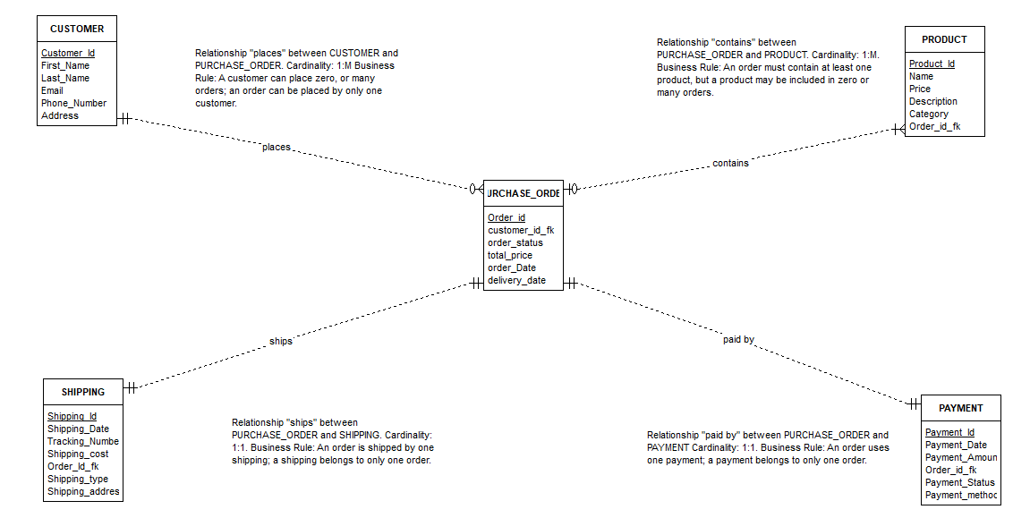
Entity – Relationship Diagram

Slide 6
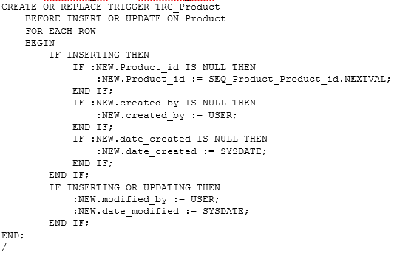
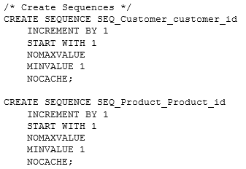
TRIGGER and SEQUENCE
Business purpose:
The TRG_Product trigger automatically assigns a sequential Product ID to a newly-inserted row in the Product table, as well as assigning appropriate values to the created_by and date_created fields.
Business purpose:
To auto-generate a Customer_ID and Product_ID which have an increment of 1 starting from 1, making the work of insertion easier.

Slide 7
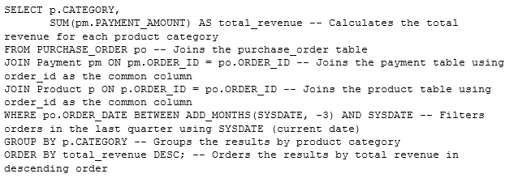
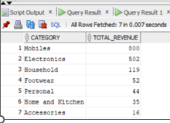
Complex Query
Retrieving information about the total revenue generated by each category of products in the last quarter.

Slide 8
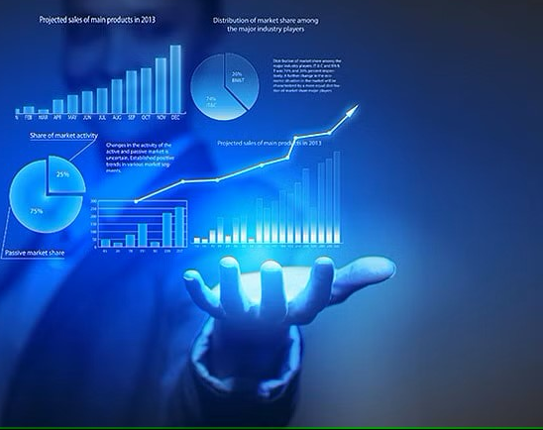
Thank you!

